Slide 1
Helmet and Number Plate Detection using YOLOv8

Slide 2
Abstract
Helmet and Number Plate Detection Using YOLOv8 is an AI-based system for real-time traffic monitoring and law enforcement. It detects motorcyclists without helmets and identifies vehicle number plates using deep learning and OCR. The system ensures high accuracy, fast processing, and scalability for deployment on edge devices or cloud platforms. By automating violation detection, it reduces manual efforts and enhances road safety. This technology helps enforce traffic laws effectively, promoting responsible driving behavior.

Slide 3
Introduction
Helmet and number plate detection is essential for ensuring road safety and enforcing traffic laws. This project uses YOLOv8, a deep learning-based object detection model, to identify motorcyclists without helmets and recognize vehicle number plates. The system processes real-time video feeds with high accuracy and speed, reducing manual monitoring efforts. Optical Character Recognition (OCR) is integrated to extract vehicle registration details for legal enforcement. This technology enhances automated traffic monitoring, promoting safer roads and compliance with regulations.

Slide 4
Existing System
The current traffic monitoring system relies heavily on manual surveillance by traffic police, which is time-consuming and inefficient. CCTV cameras are used for recording violations, but they require manual review, leading to delays in enforcement. Traditional number plate recognition systems lack real-time processing and often fail under poor lighting or occlusions. Helmet detection is mostly visual inspection-based, making it prone to human errors. Rule enforcement depends on manual ticketing, which can be inconsistent and difficult to track. The lack of automated detection and alerting mechanisms reduces the efficiency of law enforcement. Overall, existing systems struggle with scalability, accuracy, and real-time monitoring, necessitating an AI-based solution for improved efficiency.

Slide 5
Proposed system
The proposed system uses YOLOv8, an advanced deep learning model, for real-time helmet detection and number plate recognition. It automatically detects motorcyclists without helmets and extracts vehicle registration details using Optical Character Recognition (OCR). The system processes live video feeds with high accuracy, enabling quick and efficient violation detection. It eliminates the need for manual monitoring, reducing human errors and delays in enforcement. The solution is scalable and deployable on edge devices or cloud platforms for seamless integration with existing traffic management systems. Automated alerts and reports can be generated for law enforcement authorities. This AI-powered system enhances road safety, ensures compliance with traffic rules, and improves traffic monitoring efficiency.

Slide 6
Literature Review
Several studies have explored helmet detection and number plate recognition using deep learning and computer vision techniques. Traditional methods relied on image processing and feature extraction, which lacked accuracy in real-world conditions. Recent advancements in YOLO-based object detection models have significantly improved real-time detection accuracy. Research on Optical Character Recognition (OCR) has enhanced the ability to extract vehicle registration details from number plates. Many studies highlight the importance of automated traffic monitoring to reduce manual intervention and enforce safety regulations effectively. Existing works also emphasize the need for scalable and high-speed AI solutions for real-world deployment. The proposed system builds on these advancements by integrating YOLOv8 with OCR for improved accuracy and efficiency in traffic rule enforcement.

Slide 7
Modules
1. Data Collection & Preprocessing:
Gather helmet and number plate datasets from real-world traffic footage.
Perform image enhancement, annotation, and augmentation for model training.
2. Helmet Detection Module:
Utilize YOLOv8 to detect motorcyclists and identify those without helmets.
Process live video feeds for real-time monitoring and violation detection.
3. Number Plate Detection & OCR Module:
Detect vehicle number plates using YOLOv8 object detection.
Extract registration details using Optical Character Recognition (OCR) for enforcement.
4. Real-time Processing & Alert System:
Implement real-time detection with high-speed inference and minimal latency.
Generate automated alerts and reports for law enforcement authorities.
5. Database & Report Generation:
Store detected violations, vehicle details, and timestamps in a database.
Provide a user-friendly interface for retrieving and analyzing violation records.

Slide 8
Algorithms Used
1. YOLOv8 (You Only Look Once, Version 8): Used for real-time object detection to
identify motorcyclists and detect helmet violations with high accuracy.2
2. Optical Character Recognition (OCR): Extracts vehicle registration numbers from
detected number plates for further processing.
3. Convolutional Neural Networks (CNN): Utilized within YOLOv8 for feature
extraction and classification of objects in traffic images.
4. Image Processing Techniques: Applied for noise reduction, contrast enhancement,
and edge detection to improve detection accuracy.
5. Deep Learning-based Classification: Ensures high precision in distinguishing
between helmeted and non-helmeted riders, even in complex traffic scenarios.

Slide 9
Software Components:
1. Programming Language: Python
2. Frameworks & Libraries:
1. TensorFlow/Keras or PyTorch: Used for training and deploying deep learning models for helmet and number
plate detection.
2. OpenCV: Image processing and video stream handling for real-time detection.
3. Scikit-learn: Utilized for data preprocessing, model evaluation, and additional machine learning tasks.
4. Pandas & NumPy: Efficient data handling, manipulation, and numerical computations.
5. Matplotlib & Seaborn: Visualization of detection results, performance metrics, and model accuracy.
6. Streamlit: For creating a user-friendly web-based interface to display detection results and reports.
Hardware Components:
3. Processor: Intel Core i5/i7 or AMD Ryzen 5/7 (or higher) for smooth processing.
4. RAM: Minimum 8GB (16GB recommended for better model training and real-time detection).
5. Storage: Minimum 256GB SSD (512GB SSD recommended for storing datasets and models).
6. GPU (Highly Recommended): NVIDIA GTX 1650 or higher for faster deep learning inference
and model training.
7. Cloud GPU (Optional for Deployment): Google Colab Pro, AWS EC2 (Tesla T4/V100), or
Azure ML for high-performance computing and large-scale deployment.

Slide 10
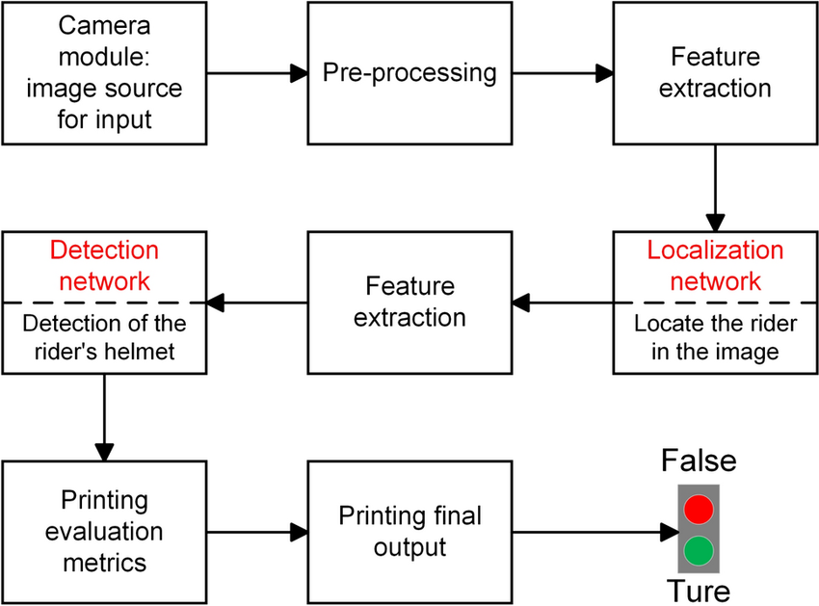
Block Diagram

Slide 11
UML Diagrams
Use Case Diagram
Data Flow Diagram
Sequence Diagram
Active Diagram

Slide 12
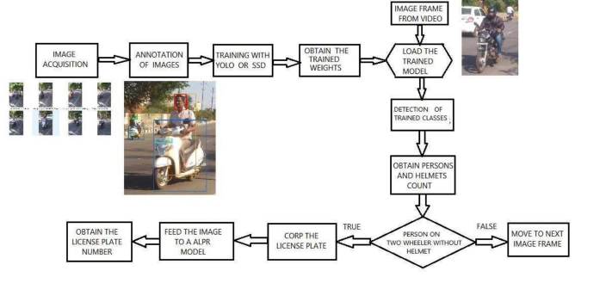
Use Case Diagram

Slide 13
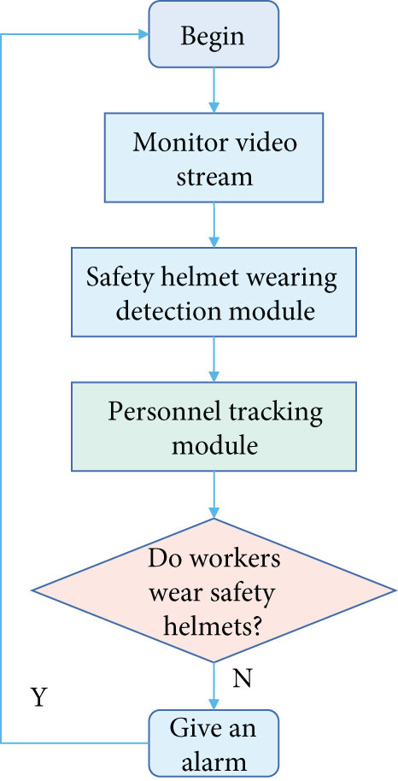
Data Flow Diagram

Slide 14
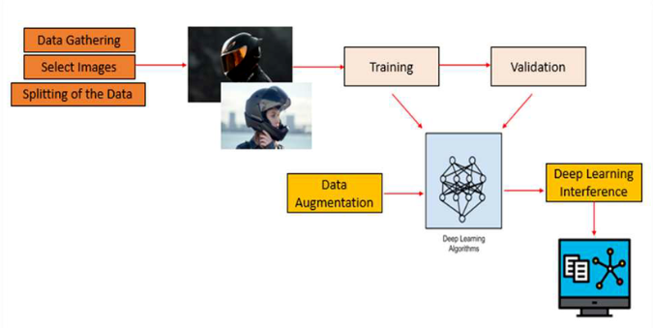
Sequence Diagram

Slide 15
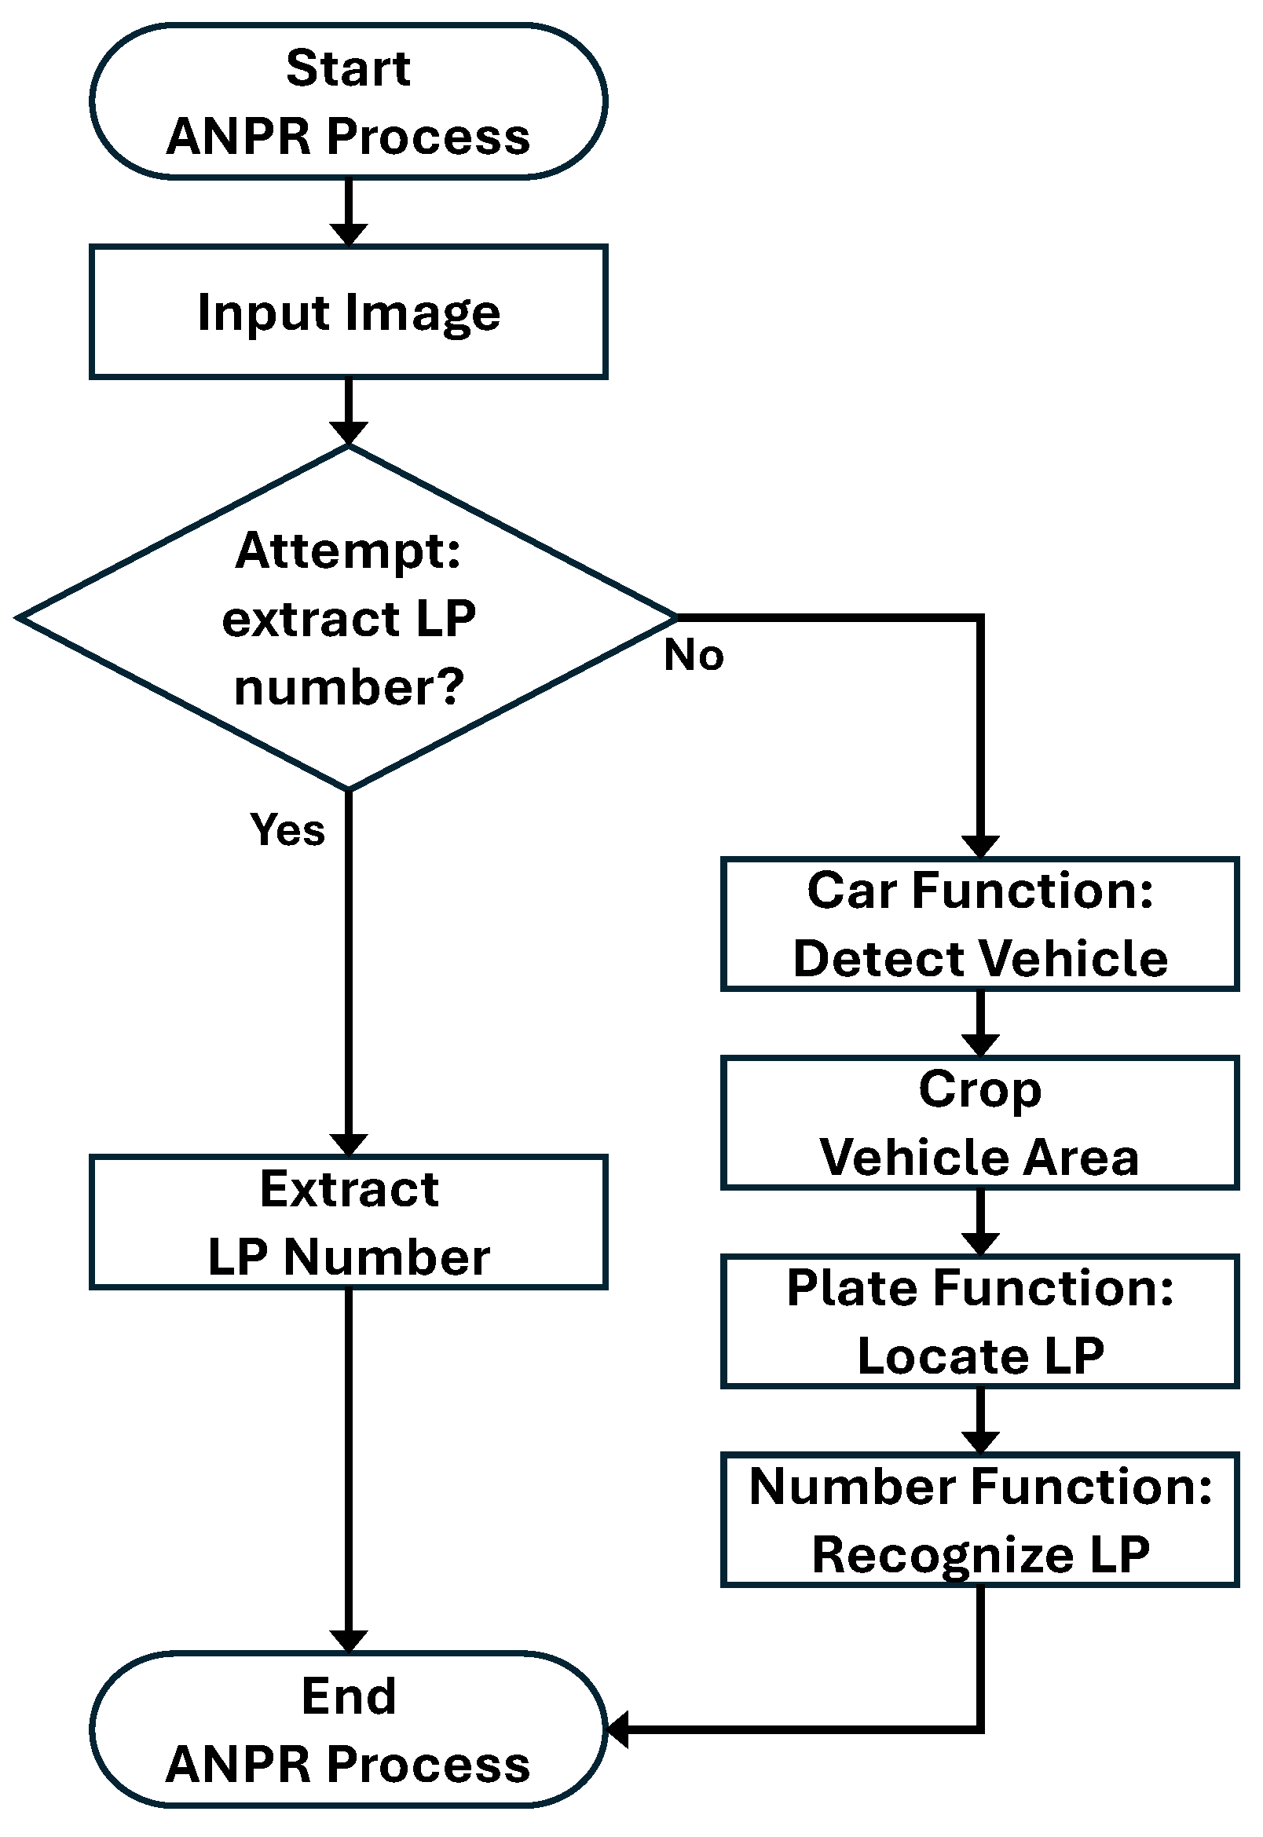
Active Diagram

Slide 16
Final Output
The system successfully detects motorcyclists without helmets in real-time using YOLOv8.
Vehicle number plates are accurately identified, and registration details are extracted using OCR.
The detection results, including violation alerts and captured images, are stored in a database.
A user-friendly interface (e.g., Streamlit) displays real-time detections and generates reports for
law enforcement.
The solution improves traffic monitoring efficiency, automates rule enforcement, and enhances
road safety.

Slide 17
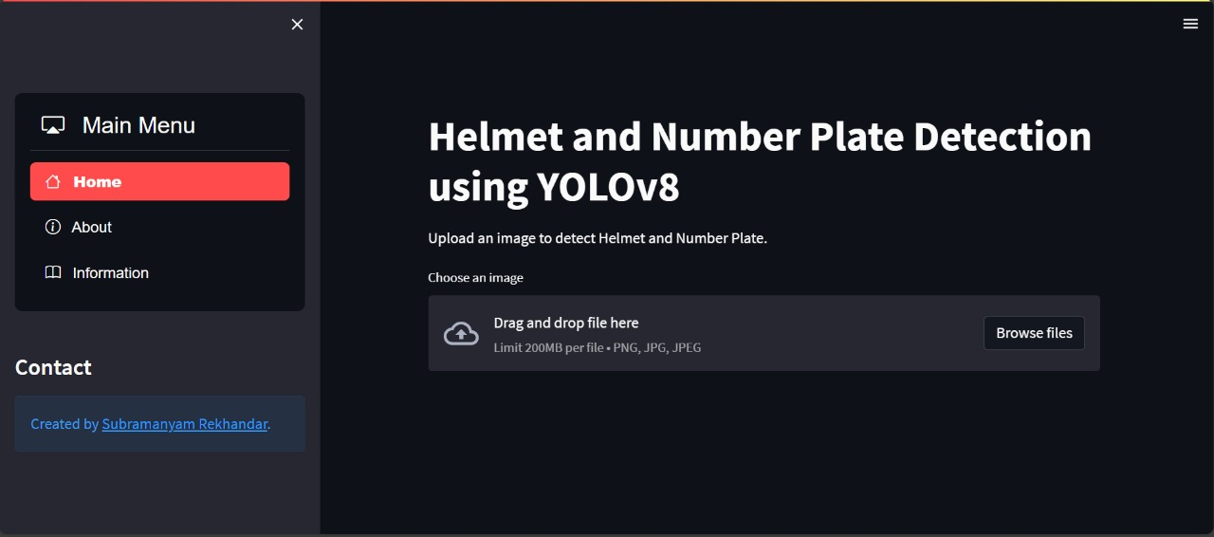
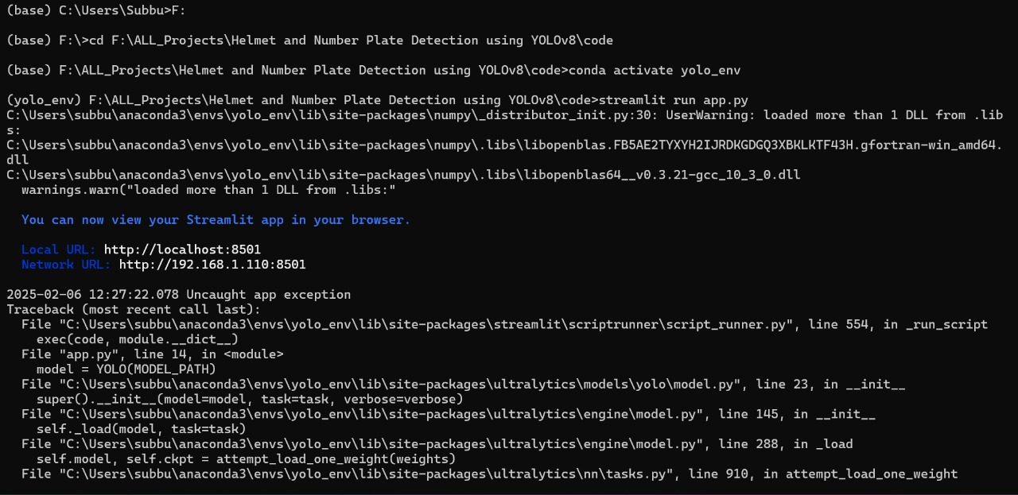
Final Output

Slide 18
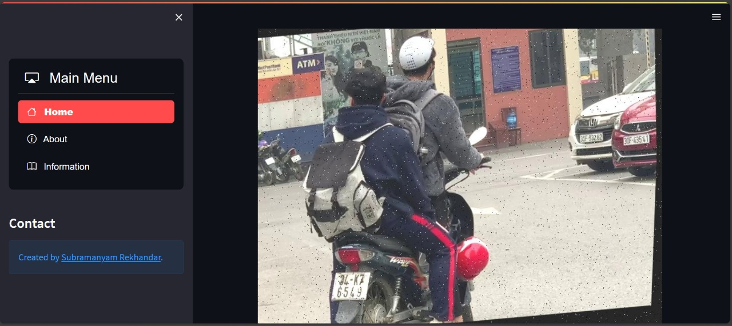
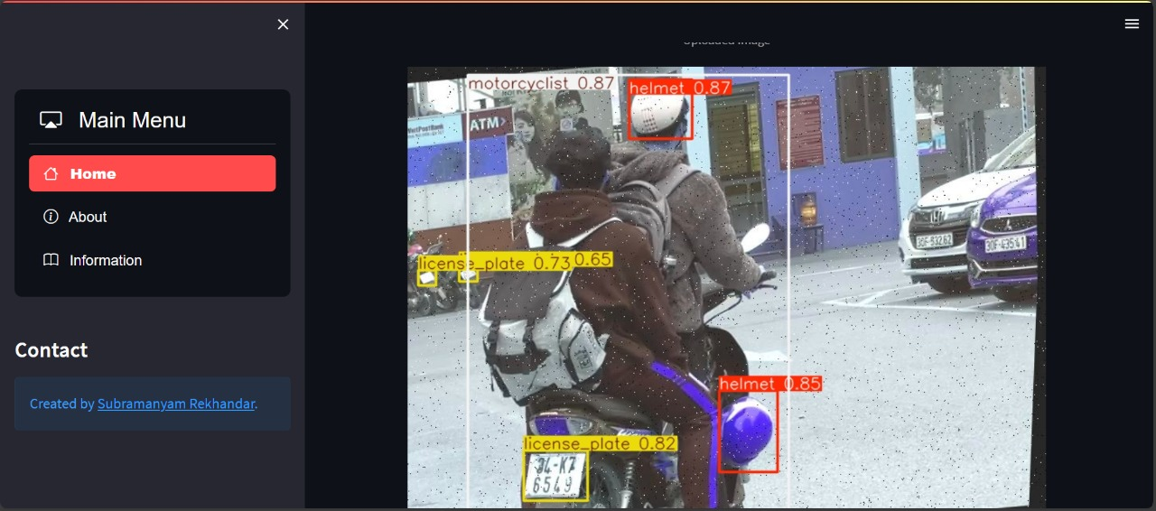
Final Output

Slide 19
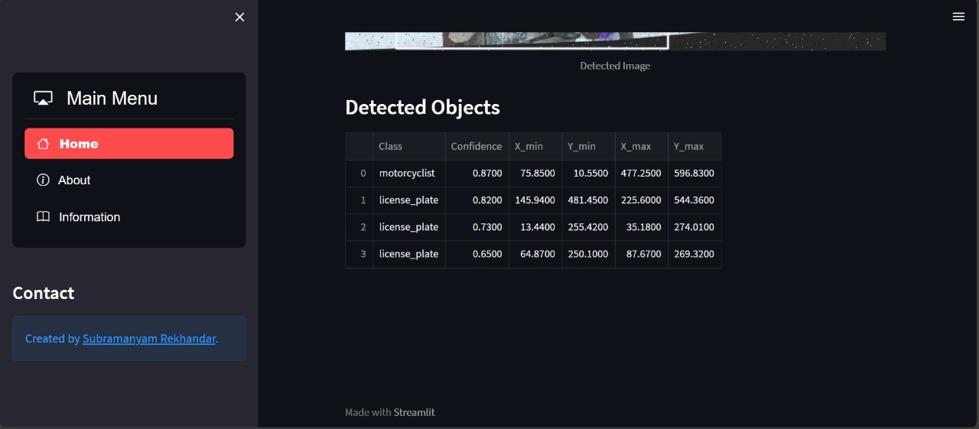
Final Output

Slide 20
Conclusion
The Helmet and Number Plate Detection System using YOLOv8 provides an efficient and automated solution for enforcing road safety rules. By utilizing deep learning and computer vision, the system accurately detects helmet violations and extracts vehicle registration details in real time. The integration of OCR and AI-driven analysis ensures reliable and scalable traffic monitoring with minimal human intervention. This solution helps law enforcement agencies improve efficiency, reduce accidents, and enhance compliance with traffic regulations. Overall, the project demonstrates the potential of AI-powered automation in transforming traffic management and ensuring safer roads.

